Slide 1


Slide 2
Practical
Superstore Data (as usual)
Link

Slide 3
Who am I?
Data Analytics Lead at Niagahoster
Experience:
3+ years on Data Role
Speaker at many campus for giving enough information about how and what to do when it comes to career.
Salary Survey with @hrdbacot: link
Linkedin

Slide 4
Today’s Menu
What we saw
Data visualization in general
Type of data viz
Practice on Looker Studio

Slide 5
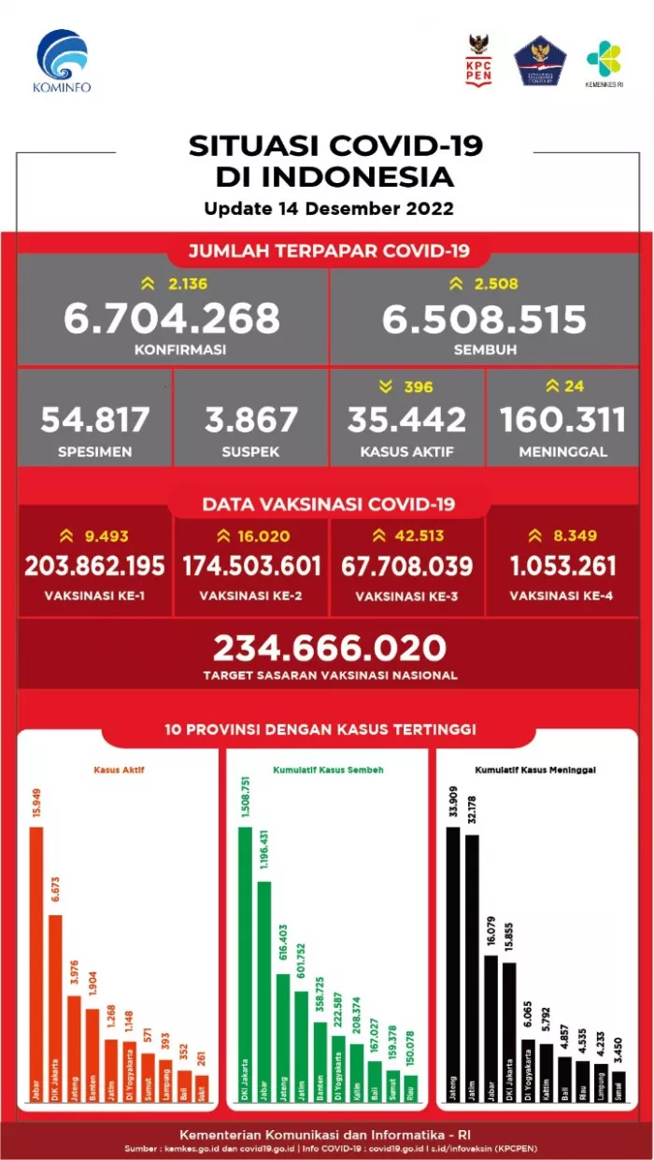
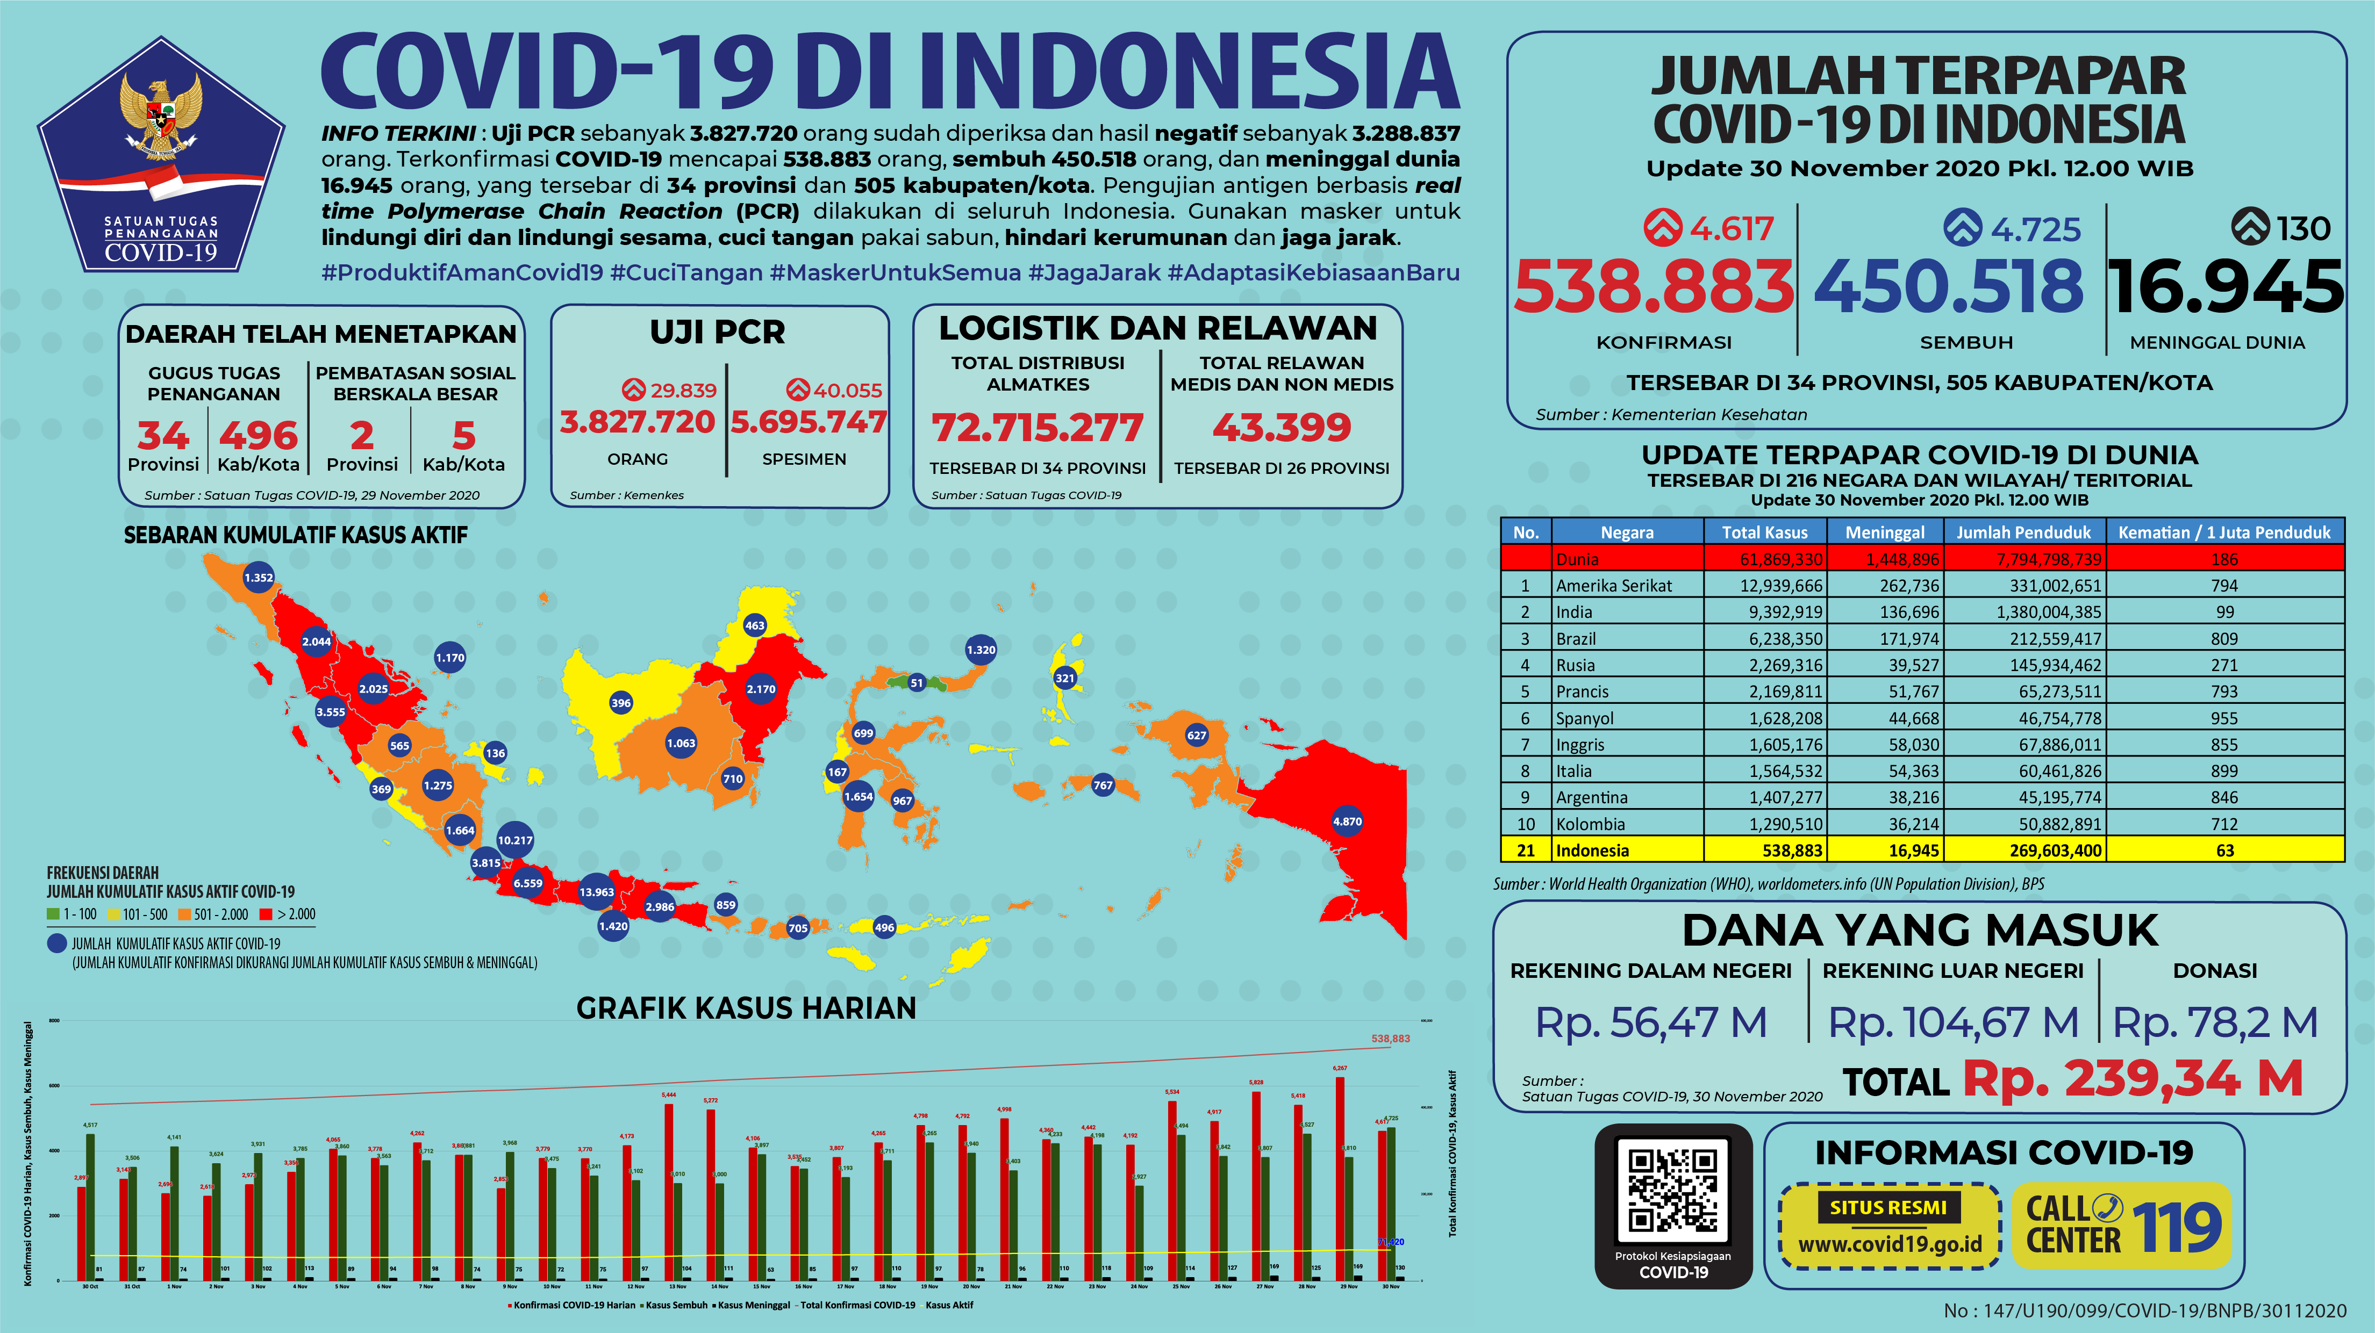

Slide 6


Data Visualization
Data visualization is the graphical representation of information and data. By using visual elements like charts, graphs, and maps, data visualization tools provide an accessible way to see and understand trends, outliers, and patterns in data. (Tableau)

Slide 7
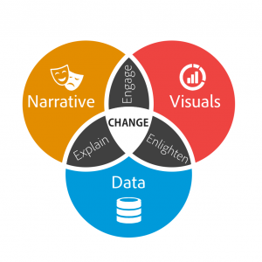
Data Storytelling

Slide 8
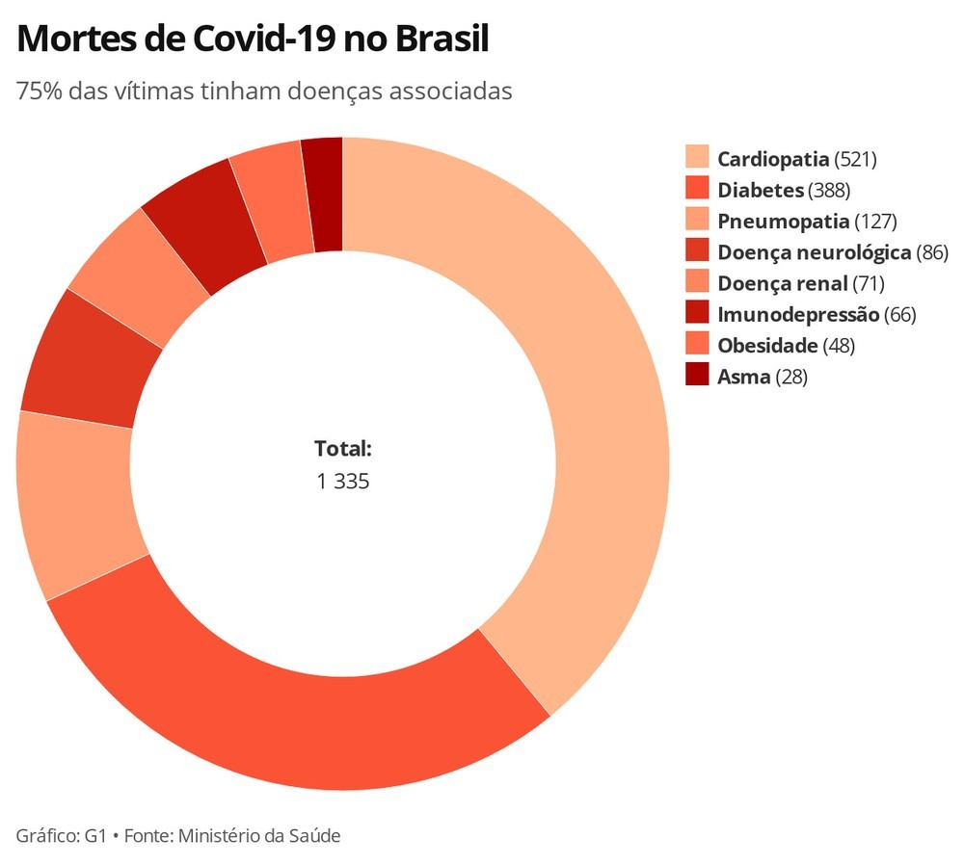
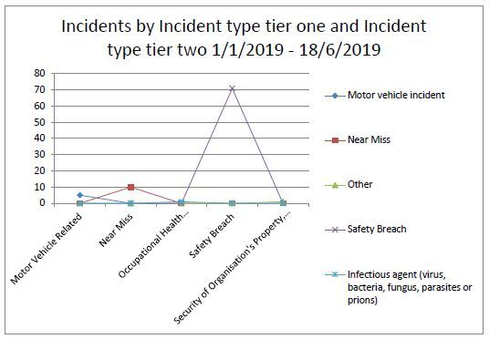
Impact

Slide 9
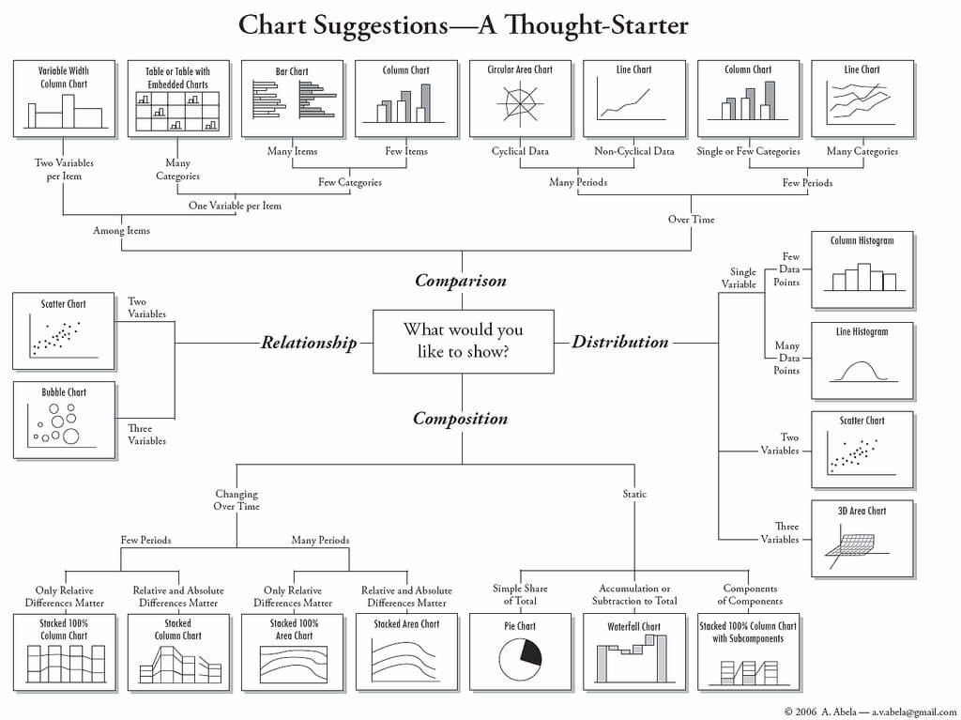
Type of Data Visualization

Slide 10
Main Thing to Know
Dimension
Metrics
Attributes of our data (Text/Number) as long as it is grouped
Quantitative measurements (Number)

Slide 11
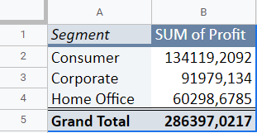
Simple Example
Find total Profit based on Segment
Total Profit (Metrics)
Segment (Dimension)

Slide 12
Practical
Superstore Data (as usual)
Link

